Slide 1

Created by:
Grzegorz Meller
Mateusz Rock
Tomasz Wierciński
Robert Zwierzycki
EVALUATING AND IMPROVING THE MODEL

Slide 2

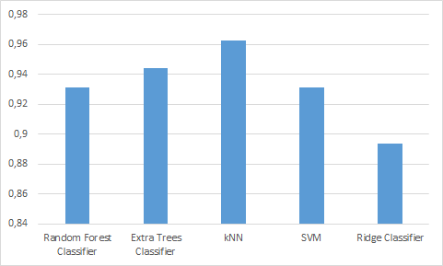
Evaluating Legendary Pokemon Classifier
We decided to evaluate our Legendary Pokemon Classifier by building Bagging Classifier on several classification algorithms. KNN came to be the best choice with n set to 5.

Slide 3
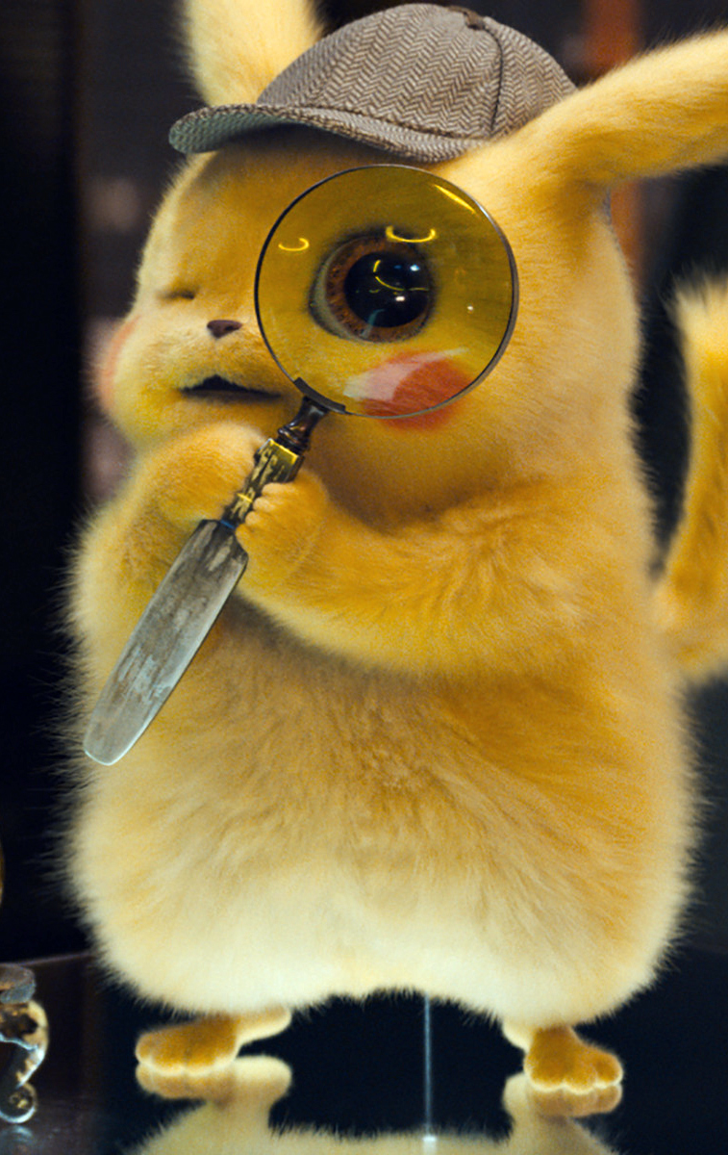
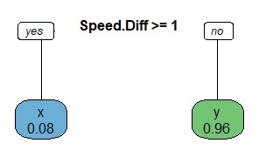
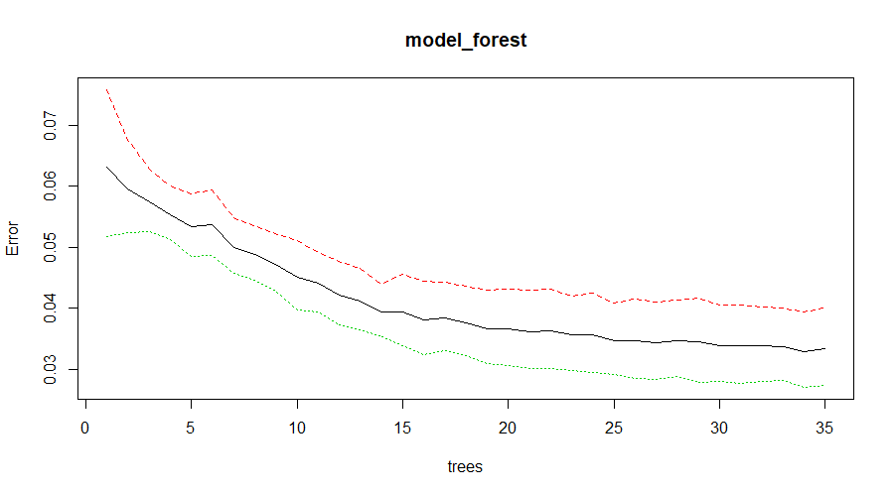
Predicting the results of
future combats

Slide 4

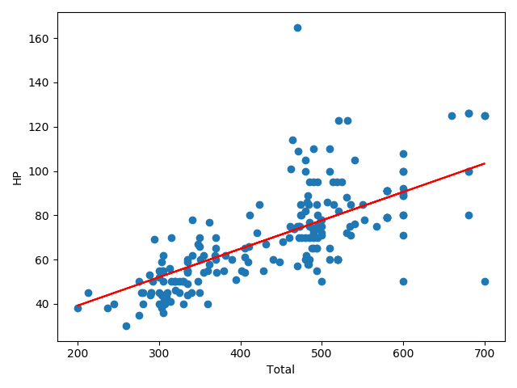
Linear Regression and Value Prediction
Size of data:800
Size of training data:600
Size of testing data:200
Model accuracy: 72,5%

Slide 5
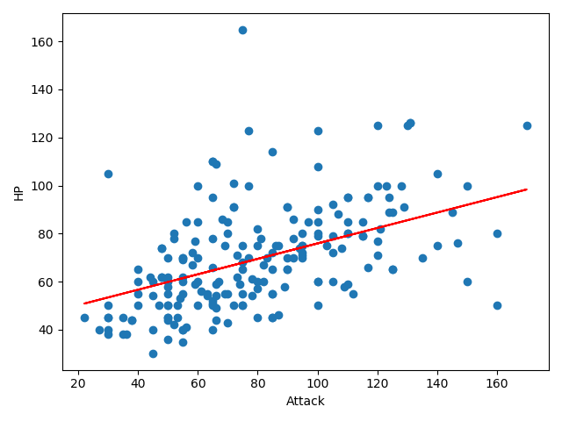
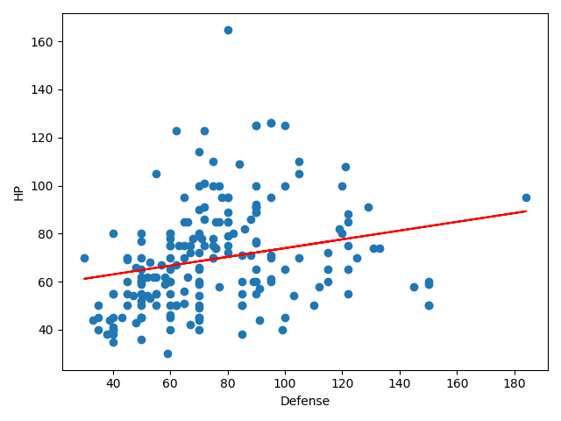
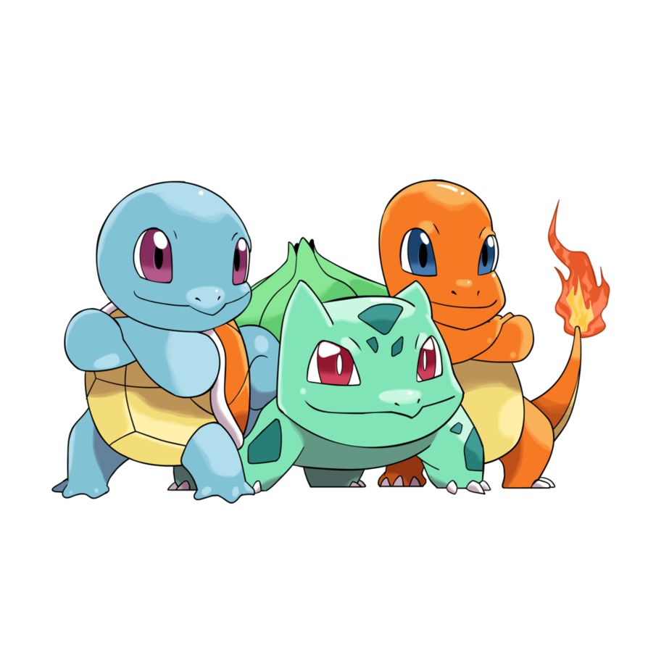
to add text

Slide 6
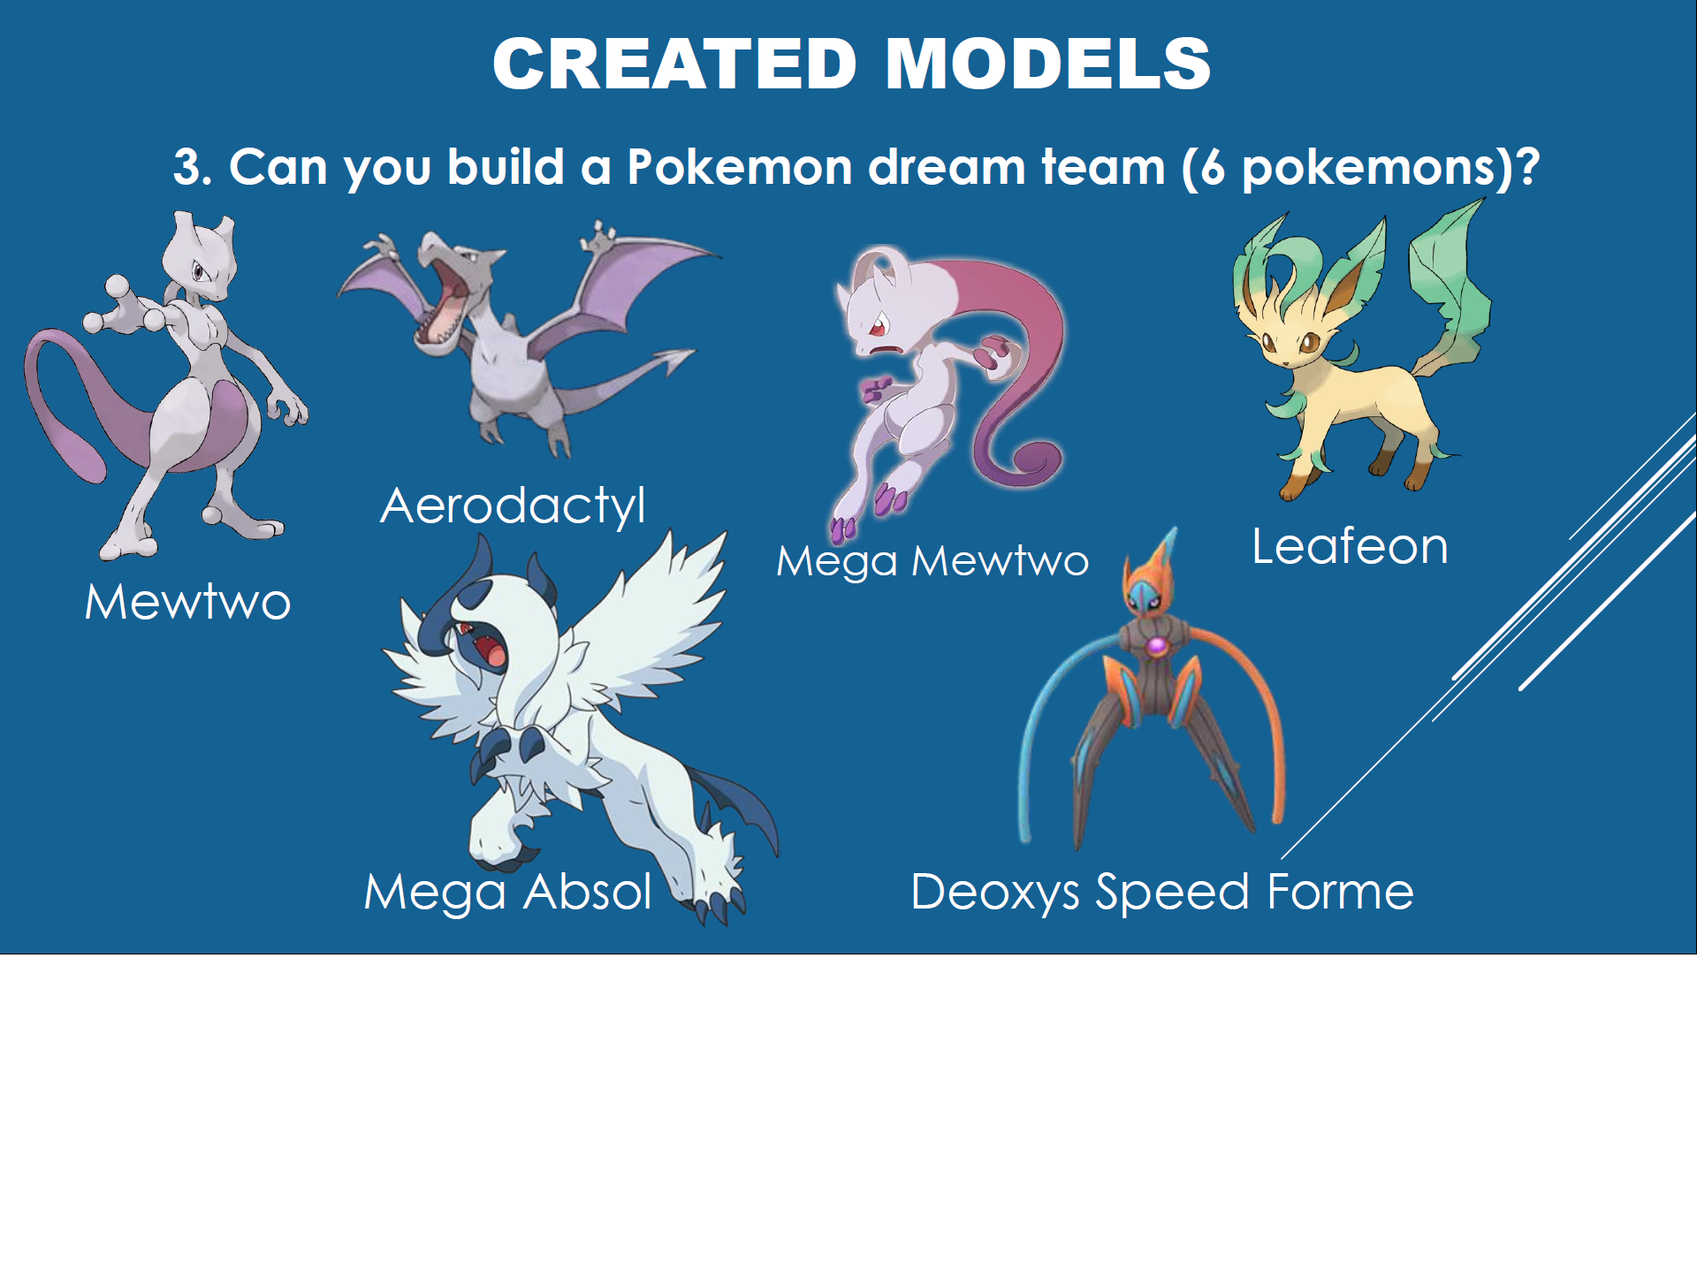

Slide 7
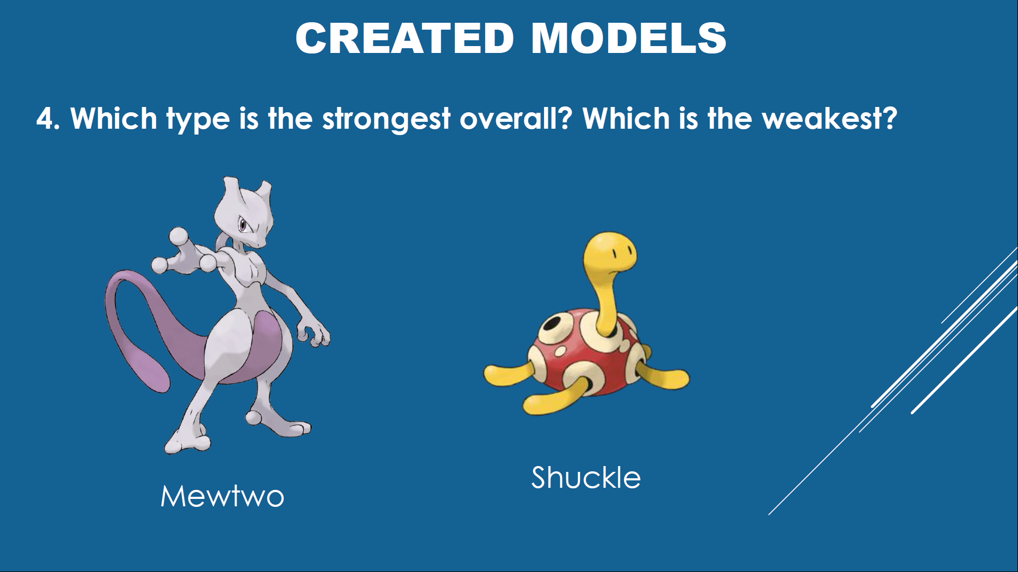

Slide 8
Thank you for your attention!

